Slide 1
Low-Light Image Enhancement
Final Project Presentation
Retinex-Net vs. Zero-DCE
資科所碩一 7110095012 黃皓偉
GitHub: https://github.com/HuangHW012/110_02_Structural-Machine-Learning-Models-and-Their-Applications

Slide 2
Paper Information
Retinex-Net
=> [1] C. Wei, W. Wang, W. Yang, and J. Liu, “Deep retinex decom- position for low-light enhancement,” (BMVC, 2018)
Zero-DCE
=> [2] C. Guo, C. Li, J. Guo, C. C. Loy, J. Hou, S. Kwong, and R. Cong, “Zero- reference deep curve estimation for low-light image enhancement,” (CVPR, 2020)
Zero-DCE++
=> [3] C. Li, C. Guo, and C. C. Loy, “Learning to enhance low-light image via zero-reference deep curve estimation,” (TPAMI, 2021)
2

Slide 3
Outline
Introduction
The Proposed Method
Experimental Results
Conclusions
Reference
3

Slide 4
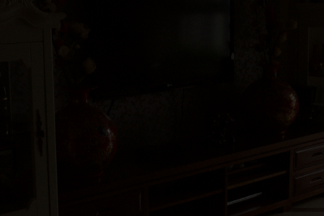
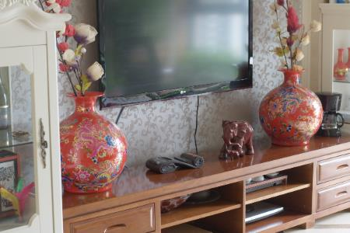
Introduction
Low-light image enhancement
(LLIE)
4

Slide 5
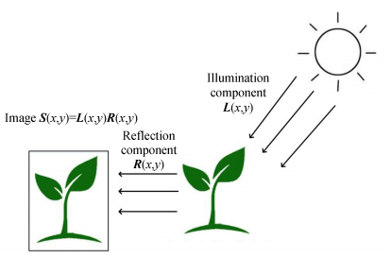
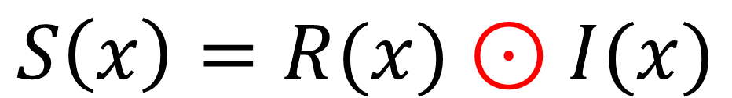
The Proposed Model Retinex-Net (1/6)
$$S\left(x\right)=R(x)⊙I(x)$$
Supervised Learning
Theory: Retinex Theory (by Edwin H. Land, 1963)
Assumptions: (illumination map)
(1) Reflectance map can reconstruct
the image with illumination map
(2) Illumination map is the local consistency
and the structure-awareness
[Reference]
Xiaojie Guo, Yu Li, and Haibin Ling. Lime: Low-light image enhancement via illumination map estimation. IEEE Transactions on Image Processing (LIME), 26(2):982–993, 2017.
Observed images can be decomposed into
the reflectance and illumination
Retinex Theory
(Retina + Cortex)
5
Notes:
1. Edwin H Land. The retinex theory of color vision. Scientific American, 237(6):108–128, 1977. 2

Slide 6
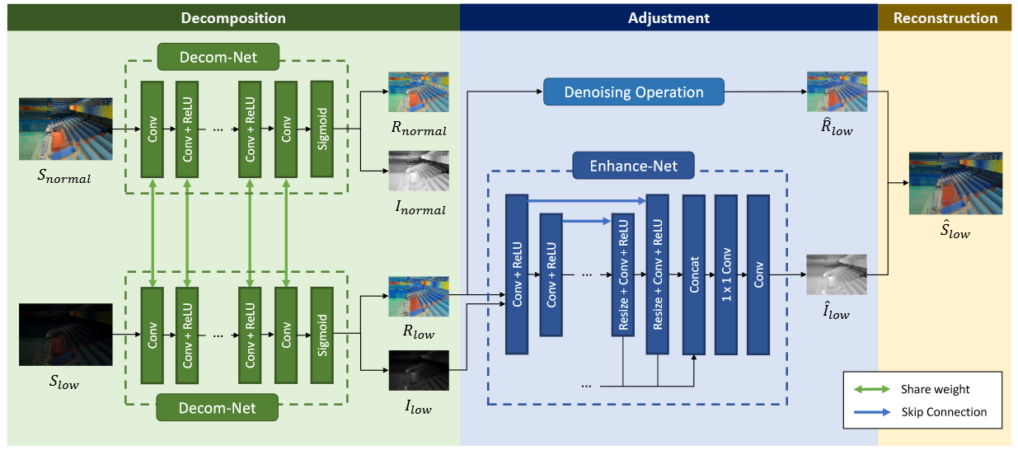
The Proposed Model Retinex-Net (2/6)
$$S\left(x\right)=R(x)⊙I(x)$$
6
Notes:
1. Decom-Net: 5 layers

Slide 7
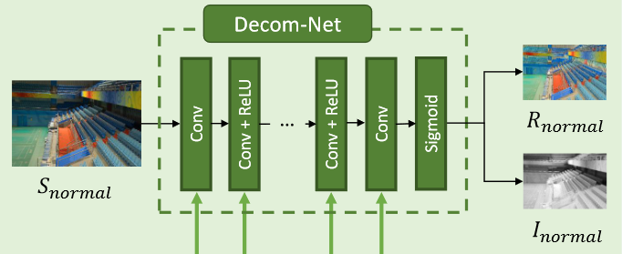
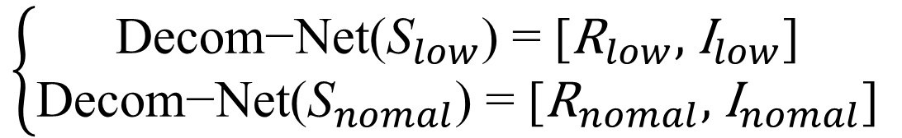
The Proposed Model Retinex-Net (3/6)
[Decom-Net]
Input : Image
2. Structure: 2D-Conv.(activation) => 5 * 2D-Conv.(ReLU)
=> 2D-Conv.(activation) => sigmoid function
(Output channels: 64 => 64 => 64 => 64 => 64 => 64 => 4)
(Kernals : 3*3 => 3 => 3 => 3 => 3 => 3 => 3)
3. Output: R, I
$$\left\{\begin{aligned}\text{Decom}\text{−}\text{Net}\text{(}{\text{S}}_{low}\text{) = [}{\text{R}}_{low}\text{,} { \text{I}}_{low}\text{]} \\ \text{Decom}\text{−}\text{Net}\text{(}{\text{S}}_{nomal}\text{) = [}{\text{R}}_{nomal}\text{,} { \text{I}}_{nomal}\text{]} \end{aligned}\right.$$
7
Notes:
1. Edwin H Land. The retinex theory of color vision. Scientific American, 237(6):108–128, 1977. 2

Slide 8
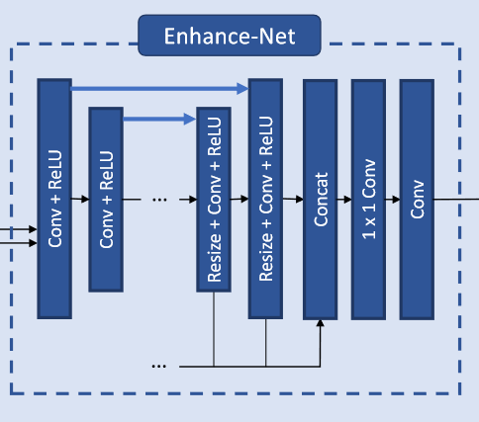
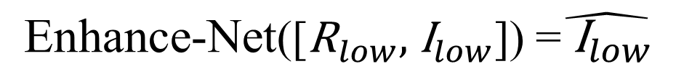
The Proposed Model Retinex-Net (4/6)
[Enhance-Net]
Input : R, I
2. Structure: Concatenate [R, I] => 2D-Conv.(activation)
=> 3 * 2D-Conv.(ReLU) => U-Net (3)
=> 2D-Conv.(activation) => 2D-Conv.(activation)
(Output channels: 64 => 64 => 64 => 64 => … => 64 => 1)
(Kernals : 3*3 => 3 => 3 => 3 => 3 => 3 => 3)
3. Output: delta (like I(x))
$$\text{Enhance}\text{−}\text{Net}\text{(}\text{[}{\text{R}}_{low}\text{,} { \text{I}}_{low}\text{]}\text{) =}\hat{{ \text{I}}_{low}}$$
8
Notes:
1. Edwin H Land. The retinex theory of color vision. Scientific American, 237(6):108–128, 1977. 2

Slide 9
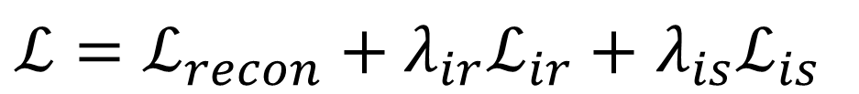
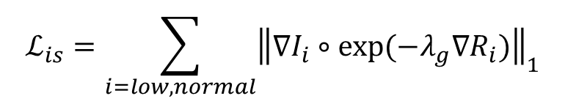
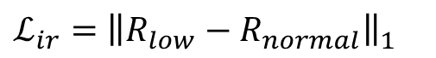
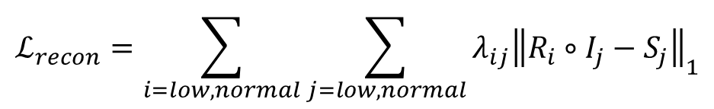
The Proposed Model Retinex-Net (5/6)
$ℒ=ℒ_{recon}+λ_{ir}ℒ_{ir}+$ $λ_{is}ℒ_{is}$
[Loss function]
Reconstruction Loss
=> by assumptions (1)
Illumination Smoothness Loss
(Structure-Aware Smoothness Loss)
=> by assumptions (2)
Invariable Reflectance Loss
=> constraining the consistency of reflectance
$$ℒ_{recon}=\sum_{i=low, normal}{\sum_{j=low,normal}{λ_{ij}{\left\|R_{i}∘I_{j}−S_{j}\right\|}_{1}}}$$
$$ℒ_{is}=\sum_{i=low, normal}{{\left\|{∇I}_{i}∘exp⁡(−λ_{g}{∇R}_{i})\right\|}_{1}}$$
$ℒ_{ir}=$ ${\left\|R_{low}−R_{normal}\right\|}_{1}$
9
Notes:
Edwin H Land. The retinex theory of color vision. Scientific American, 237(6):108–128, 1977. 2
Weights: ([1, 0.001], 0.1, 0.01) for Decom-Net; (1, 3) for Enhance-Net

Slide 10
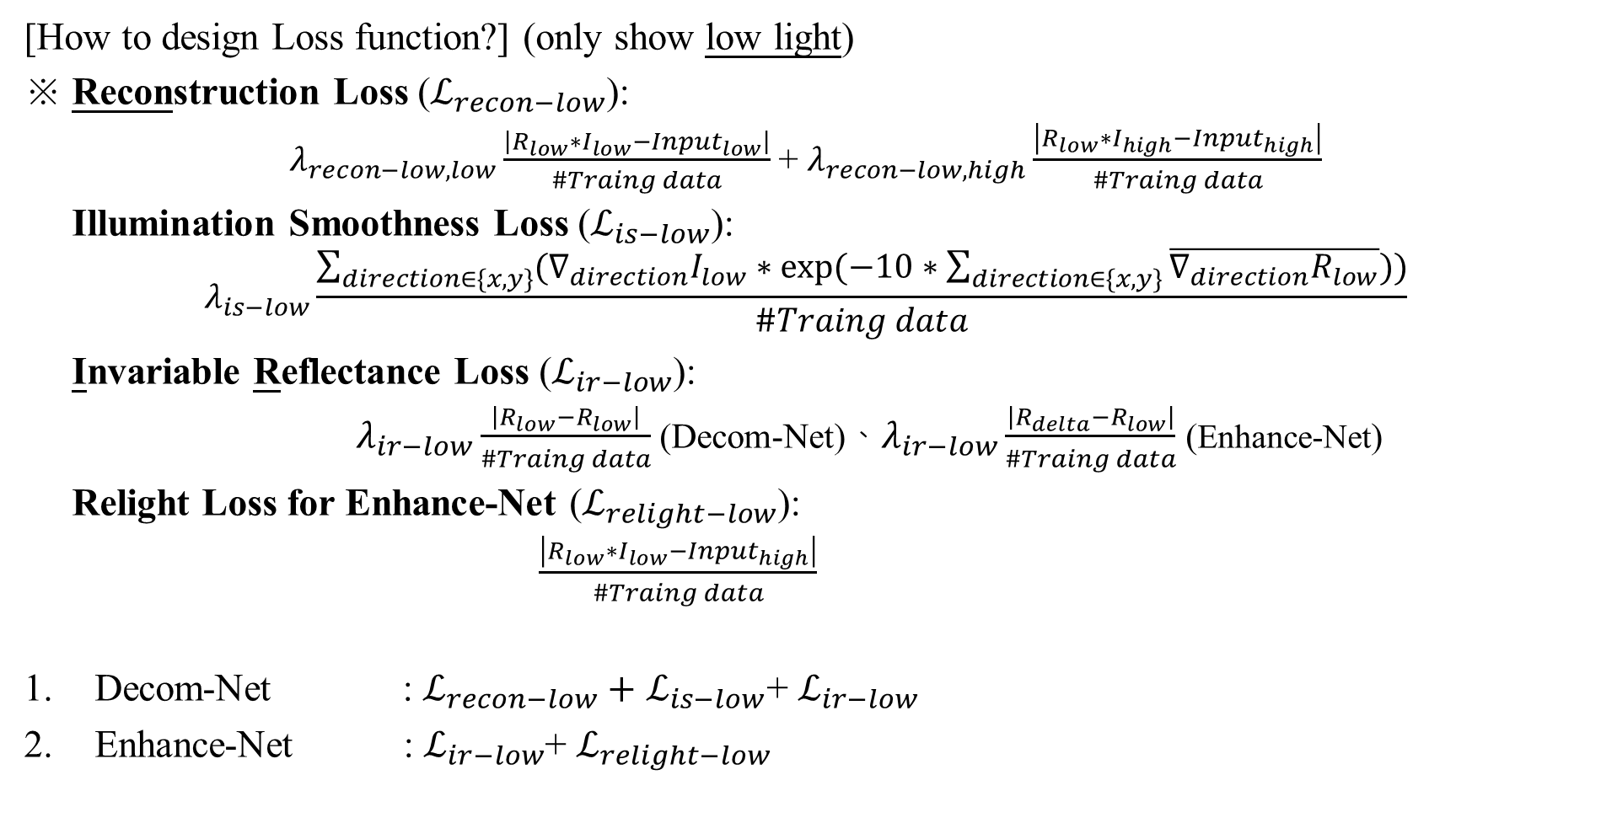
The Proposed Model Retinex-Net (6/6)
[How to design Loss function?] (only show low light)
※ Reconstruction Loss ($ℒ_{recon−low}$):
$λ_{recon−low,low}\frac{\left|R_{low}∗I_{low}−{Input}_{low}\right|}{\#Traing data}$ + $λ_{recon−low,high}\frac{\left|R_{low}∗I_{high}−{Input}_{high}\right|}{\#Traing data}$
Illumination Smoothness Loss ($ℒ_{is−low}$):
$$λ_{is−low}\frac{\sum_{direction∈\{x, y\}}{({∇_{direction}I}_{low}∗exp⁡(−10∗\sum_{direction∈\{x, y\}}{\overline{∇_{direction}R_{low}}}))}}{\#Traing data}$$
Invariable Reflectance Loss ($ℒ_{ir−low}$):
$λ_{ir−low}\frac{\left|R_{low}−R_{low}\right|}{\#Traing data}$ (Decom-Net)、$λ_{ir−low}\frac{\left|R_{delta}−R_{low}\right|}{\#Traing data}$ (Enhance-Net)
Relight Loss for Enhance-Net ($ℒ_{relight−low}$):
$\frac{\left|R_{low}∗I_{low}−{Input}_{high}\right|}{\#Traing data}$
Decom-Net : $ℒ_{recon−low}+$ $ℒ_{is−low}$+ $ℒ_{ir−low}$
Enhance-Net : $ℒ_{ir−low}$+ $ℒ_{relight−low}$
10
Notes:
Weights: (1, 0.001, 0.1) for Decom-Net; (1, 3) for Enhance-Net

Slide 11
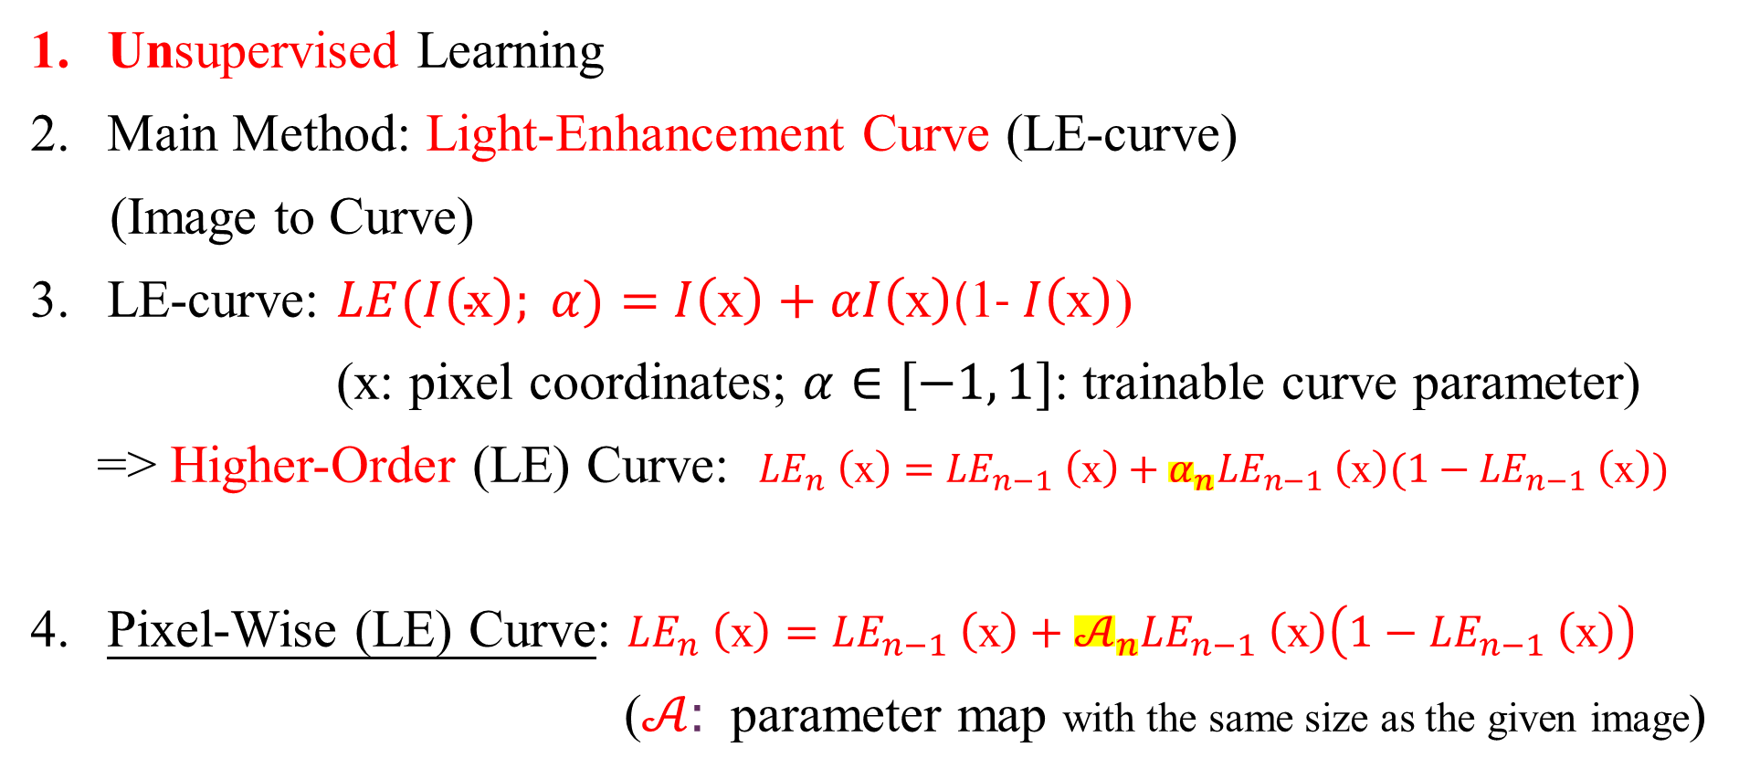
The Proposed Model Zero-DCE (1/7)
Unsupervised Learning
Main Method: Light-Enhancement Curve (LE-curve)
(Image to Curve)
LE-curve: $LE(I\left(\text{x}\right); α)=$ $I\left(\text{x}\right)+αI\left(\text{x}\right)$(1- $I\left(\text{x}\right)$)
(x: pixel coordinates; $α∈[−1, 1]$: trainable curve parameter)
=> Higher-Order (LE) Curve: ${LE}_{n} \left(\text{x}\right)={LE}_{n−1} \left(\text{x}\right)+α_{n}{LE}_{n−1} \left(\text{x}\right)(1−{LE}_{n−1} \left(\text{x}\right))$
Pixel-Wise (LE) Curve: ${LE}_{n} \left(\text{x}\right)={LE}_{n−1} \left(\text{x}\right)+𝒜_{n}{LE}_{n−1} \left(\text{x}\right)\left(1−{LE}_{n−1} \left(\text{x}\right)\right)$
($𝒜$: parameter map with the same size as the given image)
11
Notes:
Each pixel is normalized to [0, 1]
n= 8 in this paper , which can deal with most cases satisfactory

Slide 12

The Proposed Model Zero-DCE (2/7)
[Light-Enhancement Curve (LE-curve)]
※ Inspired by the curves adjustment used in photo editing software
Three objectives/ conditions in the design of LE-curve
Range of each pixel value of the enhanced image => [0,1]
LE-curve => monotonous (to preserve the differences of neighboring pixels)
LE-curve => simple, differentiable (backpropagation)
12
Notes:
Reference: https://zhuanlan.zhihu.com/p/211258182

Slide 13
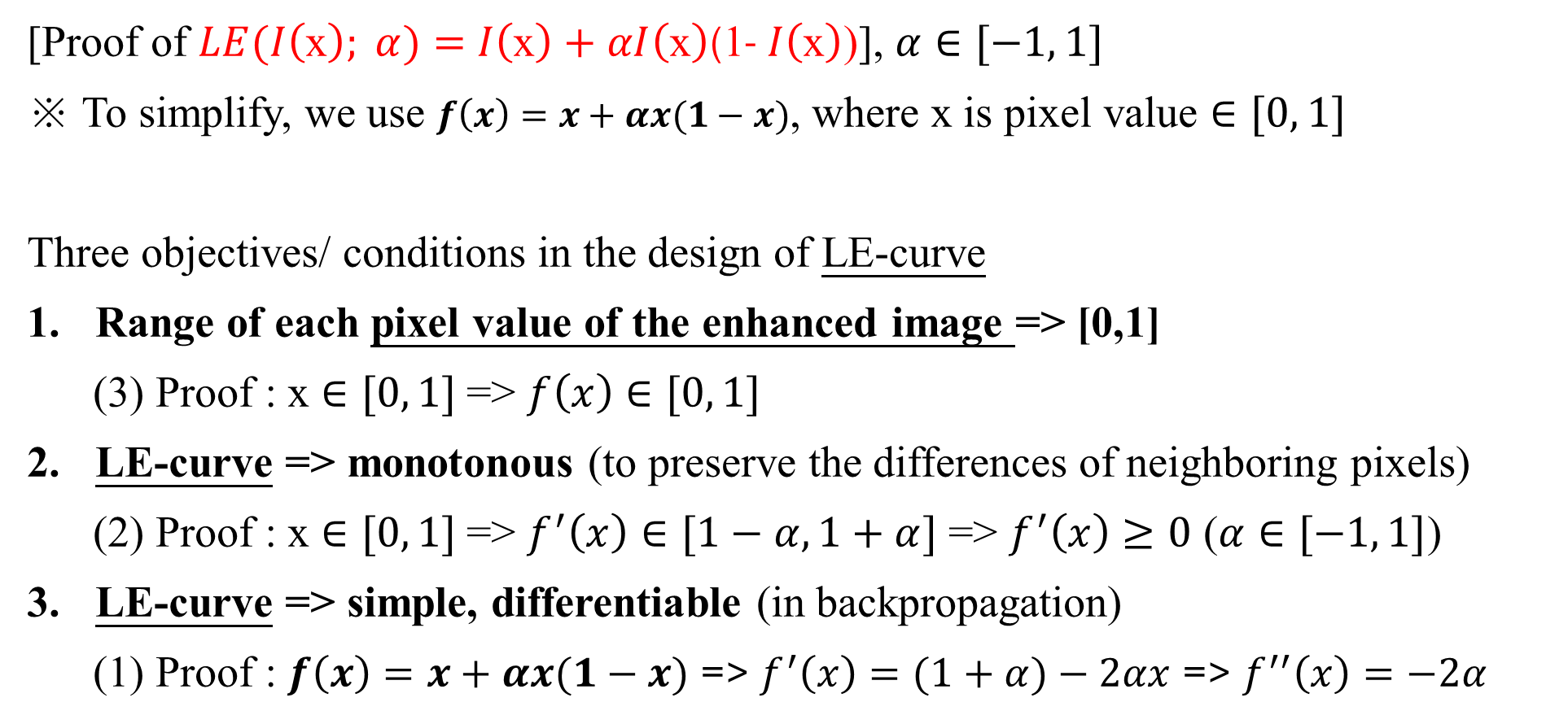
The Proposed Model Zero-DCE (3/7)
[Proof of $LE(I\left(\text{x}\right); α)=$ $I\left(\text{x}\right)+αI\left(\text{x}\right)$(1- $I\left(\text{x}\right)$)], $α∈[−1, 1]$
※ To simplify, we use $f\left(x\right)=x+αx(1−x)$, where x is pixel value $∈[0, 1]$
Three objectives/ conditions in the design of LE-curve
Range of each pixel value of the enhanced image => [0,1]
(3) Proof : x $∈[0, 1]$=> $f\left(x\right)$ $∈[0, 1]$
LE-curve => monotonous (to preserve the differences of neighboring pixels)
(2) Proof : x $∈[0, 1]$=> $f^{′}\left(x\right)∈[1−α,1+α]$ => $f^{′}\left(x\right)≥0$ ($α∈[−1, 1]$)
LE-curve => simple, differentiable (in backpropagation)
(1) Proof : $f\left(x\right)=x+αx(1−x)$ => $f^{′}\left(x\right)=(1+α)−2αx$ => $f^{′′}\left(x\right)=−2α$
13
Notes:
Reference: https://zhuanlan.zhihu.com/p/211258182

Slide 14
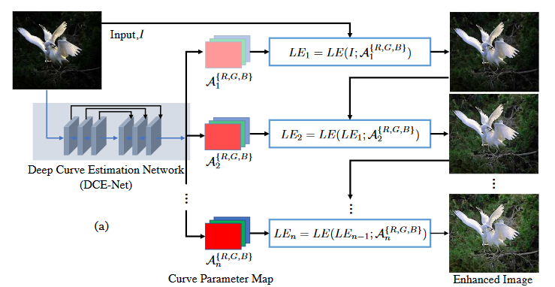
The Proposed Model Zero-DCE (4/7)
14
Notes:
1. Loss function: cross entropy

Slide 15
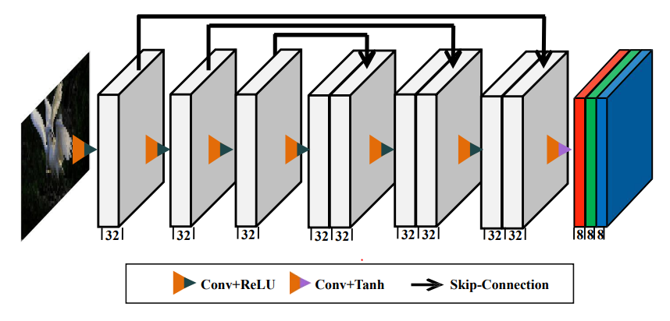
The Proposed Model Zero-DCE (5/7)
Kernel size = 3
Stride = 1
The architecture of DCE-Net
15
Notes:
1. CNN-based model

Slide 16
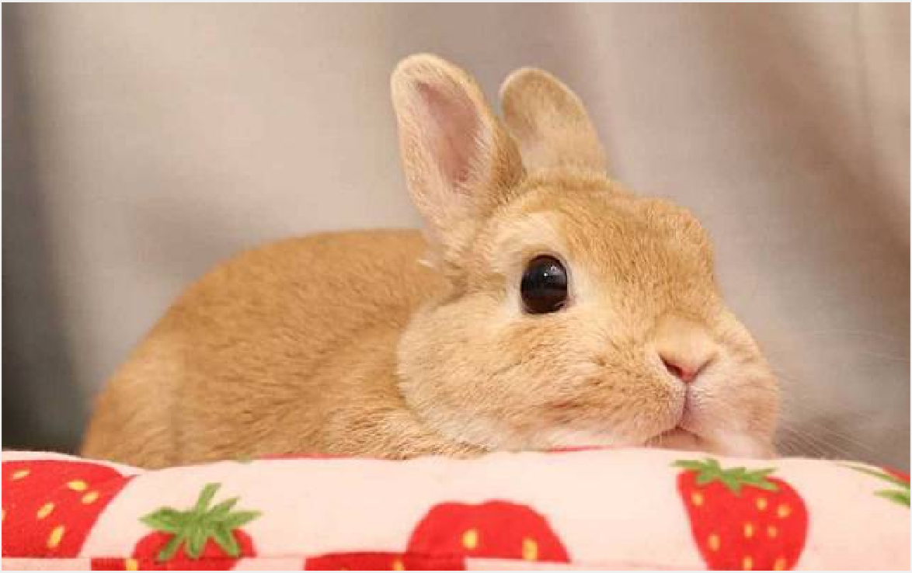
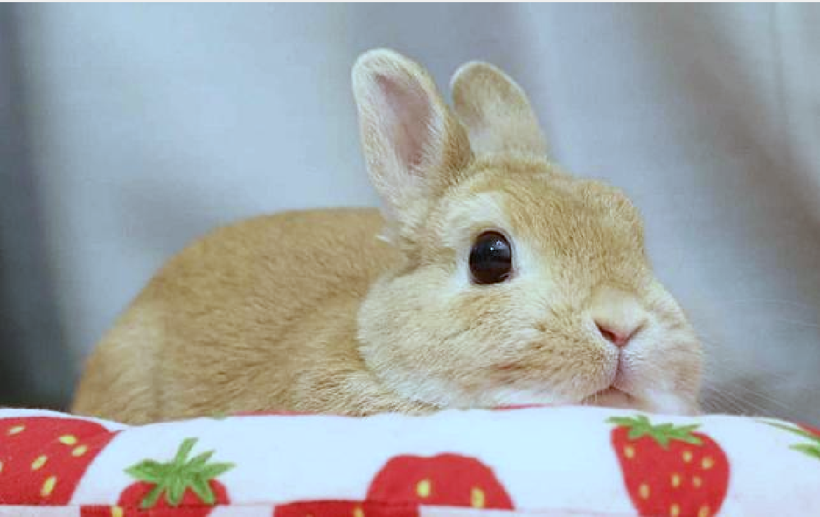
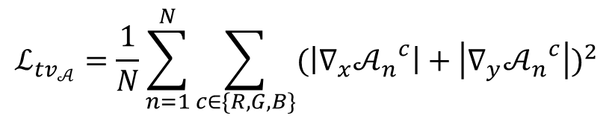
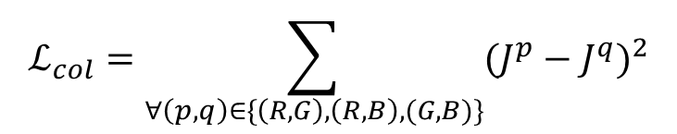
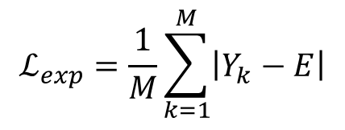
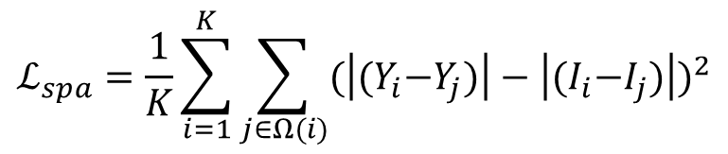
The Proposed Model Zero-DCE (6/7)
Gray World
$$ℒ=ℒ_{spa}+ℒ_{exp}+W_{col}ℒ_{col}+W_{tv_{𝒜}}ℒ_{tv_{𝒜}}$$
[Loss function] (Non-Reference Loss)
Spatial Consistency Loss
=> preserving the difference of neighboring regions
Exposure Control Loss (E = 0.6)
=> controlling the exposure level
Color Constancy Loss (Gray World)
=> correcting the potential color deviations
Illumination Smoothness Loss
=> preserving the monotonicity relations between neighboring pixels
$$ℒ_{spa}=\frac{1}{K}\sum_{i=1}^{K}{\sum_{j∈Ω(i)}{{(\left|{(Y}_{i}−Y_{j})\right|−\left|{(I}_{i}−I_{j})\right|)}^{2}}}$$
$$ℒ_{exp}=\frac{1}{M}\sum_{k=1}^{M}{\left|Y_{k}−E\right|}$$
$$ℒ_{col}=\sum_{∀\left(p, q\right)∈\{\left(R, G\right), \left(R, B\right), (G, B)\}}{{(J^{p}−J^{q})}^{2}}$$
$$ℒ_{tv_{𝒜}}=\frac{1}{N}\sum_{n=1}^{N}{\sum_{c∈\{R, G, B\}}{{(\left|∇_{x}{𝒜_{n}}^{c}\right|+\left|∇_{y}{𝒜_{n}}^{c}\right|)}^{2}}}$$
16
Notes:
Loss function: cross entropy
Tv: Total variation minimization
Exposure Control Loss : 1-norm => 2-norm
Weight: 1, 10, 5, 200

Slide 17
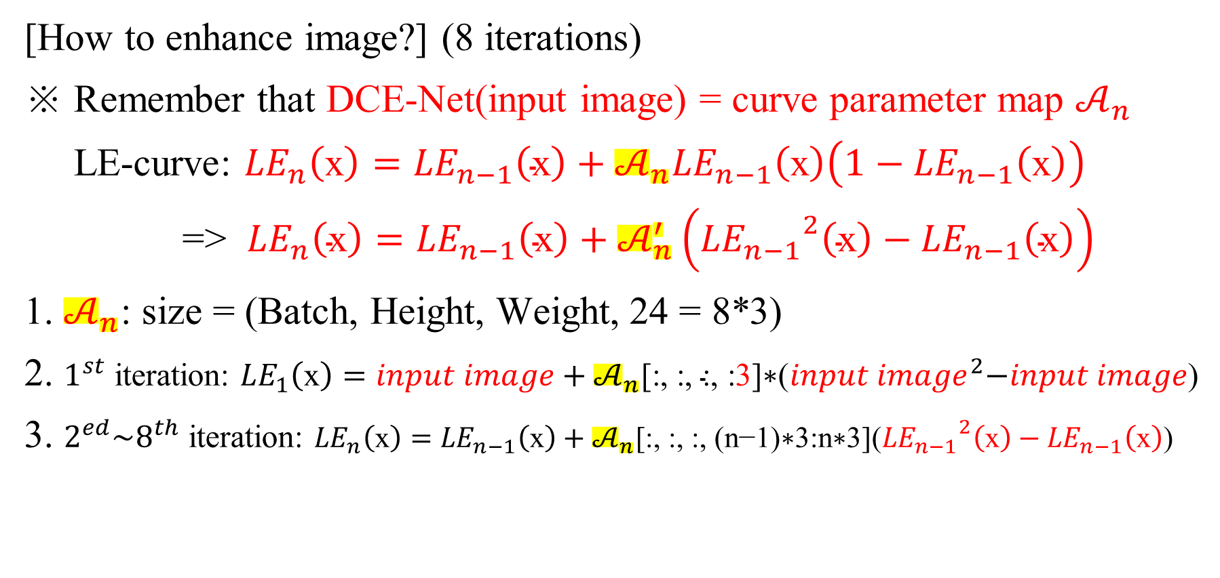
The Proposed Model Zero-DCE (7/7)
[How to enhance image?] (8 iterations)
※ Remember that DCE-Net(input image) = curve parameter map $𝒜_{n}$
LE-curve: ${LE}_{n}\left(\text{x}\right)={LE}_{n−1}\left(\text{x}\right)+𝒜_{n}{LE}_{n−1}\left(\text{x}\right)\left(1−{LE}_{n−1}\left(\text{x}\right)\right)$
=> ${LE}_{n}\left(\text{x}\right)={LE}_{n−1}\left(\text{x}\right)+𝒜_{n}^{′}\left({{LE}_{n−1}}^{2}\left(\text{x}\right)−{LE}_{n−1}\left(\text{x}\right)\right)$
1. $𝒜_{n}$: size = (Batch, Height, Weight, 24 = 8*3)
2. $1^{st}$ iteration: ${LE}_{1}\left(\text{x}\right)=input image+𝒜_{n}\text{[:, :, :, }\text{:}\text{3}\text{]}\text{∗(}{input image}^{2}\text{−}input image\text{)}$
3. $2^{ed}\sim 8^{th}$ iteration: ${LE}_{n}\left(\text{x}\right)={LE}_{n−1}\left(\text{x}\right)+𝒜_{n}\text{[:, :, :, }\text{(}\text{n}\text{−1)∗3:}\text{n}\text{∗3](}{{LE}_{n−1}}^{2}\left(\text{x}\right)−{LE}_{n−1}\left(\text{x}\right)\text{)}$
17
Notes:
Loss function: cross entropy
Tv: variation minimization

Slide 18
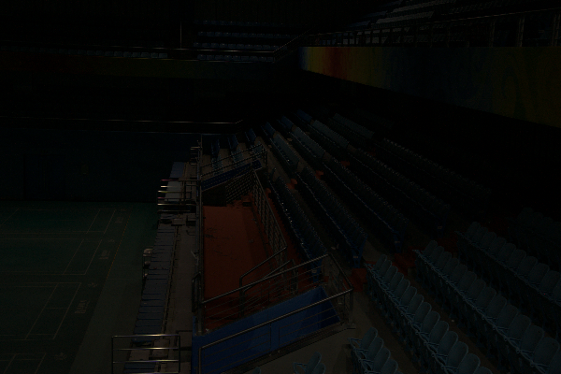
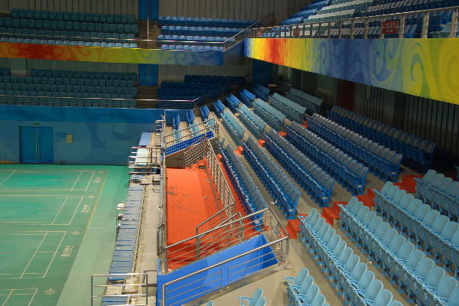
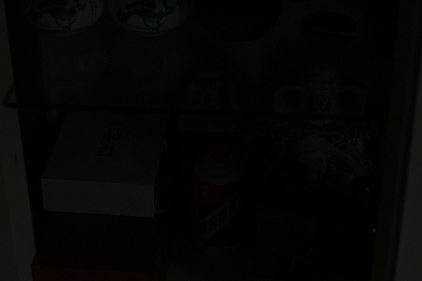
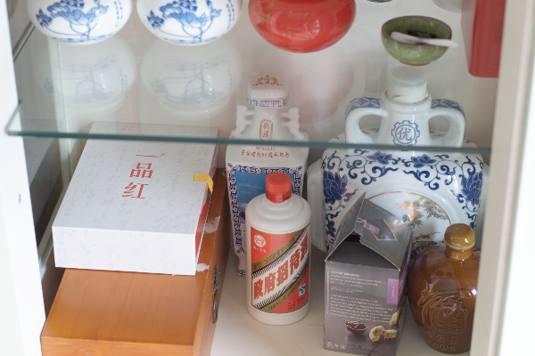
Experimental Results (1/10)
[Dataset]
LOL dataset (paired dataset): [1] Retinex-Net (~347 M)
※ Training set (our485): low light + high light
Test set (eval15) : low light + high light
Training set
Test set
18

Slide 19

Experimental Results (2/10)
[Experimental Settings]
Resize image to 256 X 256 (RGB channel)
Preprocessing : [0, 255] -> [0, 1]
Batch size: 8
Epochs : 100
Optimizer : Adam (learning rate = 0.0002/ 0.0001)
[Dataset splitting]
our485: 350 photos (~72%) for training,
135 photos (~28%) for validation
19

Slide 20
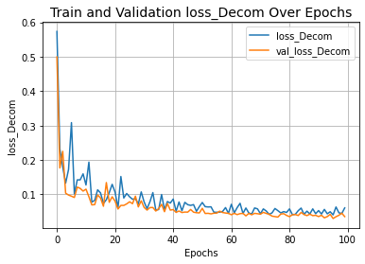
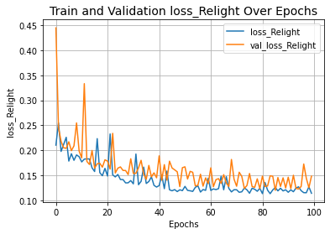
Experimental Results (3/10)
[Retinex-Net]
Loss of Decom-Net
Enhance-Net
20

Slide 21
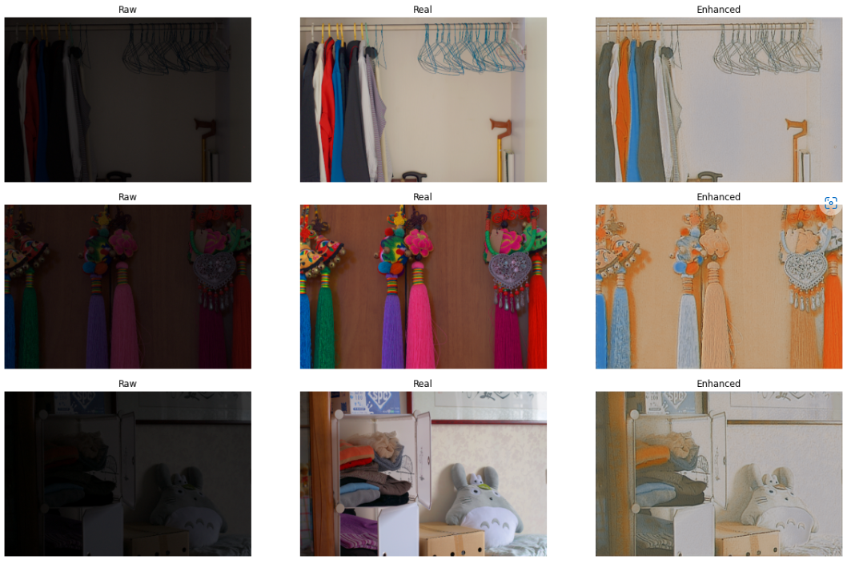
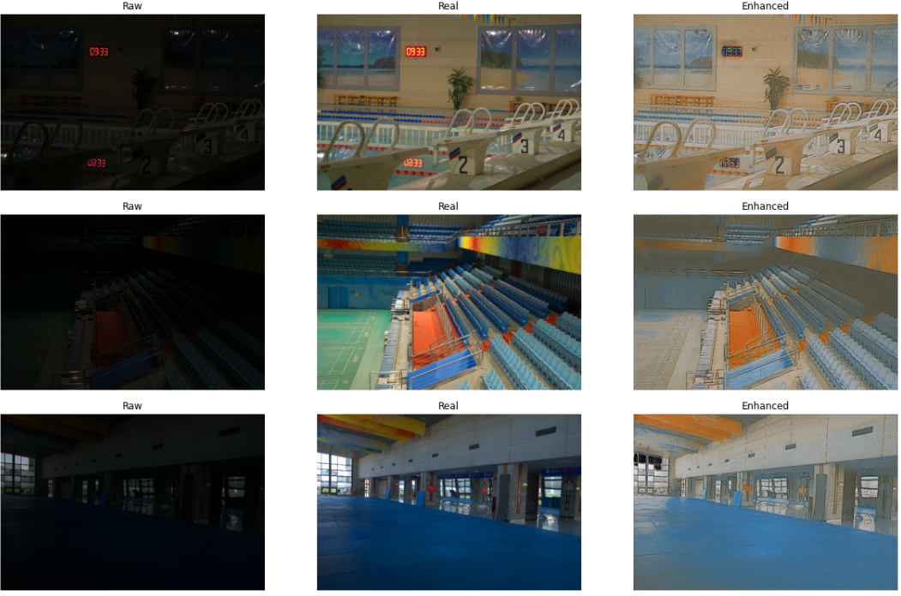
Experimental Results (4/10)
[Retinex-Net]
21

Slide 22
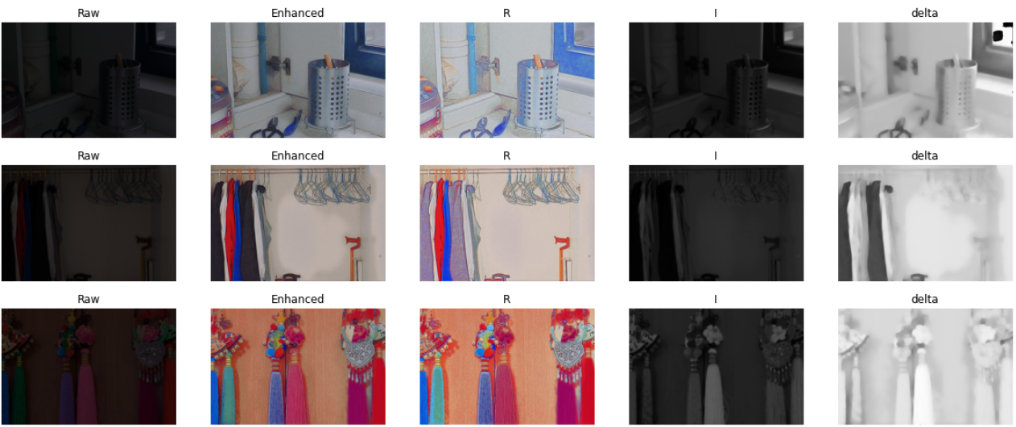
Experimental Results (5/10)
[Retinex-Net]
Decom-Net
Enhance-Net
22

Slide 23
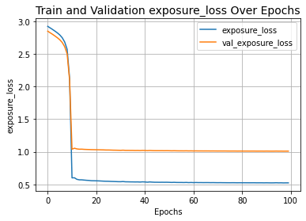
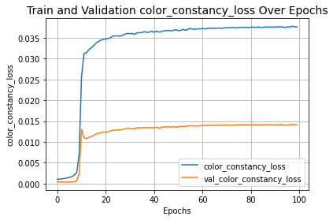
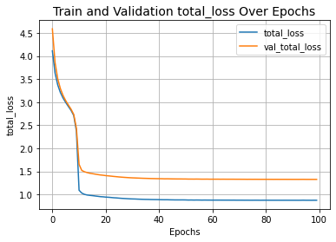
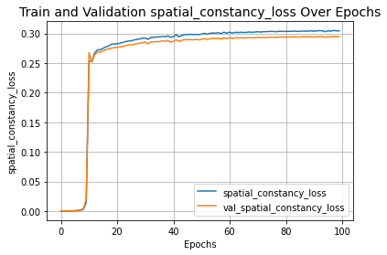
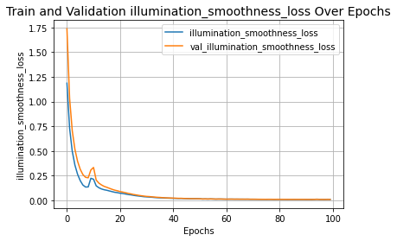
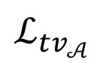
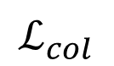
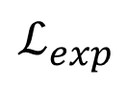
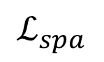
Experimental Results (6/10)
[Zero-DCE]
$$ℒ_{exp}$$
$$ℒ_{col}$$
Total Loss
$$ℒ_{spa}$$
$$ℒ_{tv_{𝒜}}$$
23

Slide 24
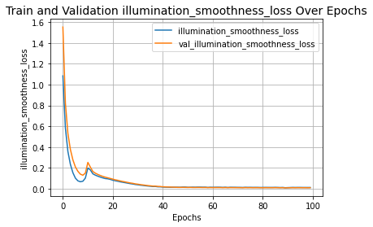
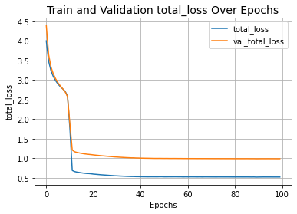
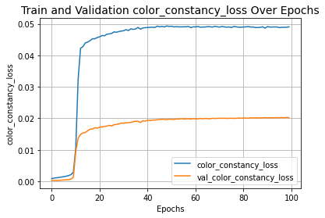

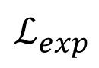
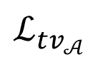
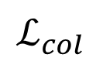
Experimental Results (/)
[Zero-DCE (no spa loss)]
$$ℒ_{tv_{𝒜}}$$
Total Loss
$$ℒ_{col}$$
$$ℒ_{exp}$$
24

Slide 25
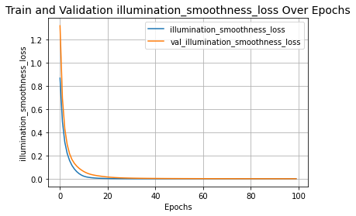






Experimental Results (/)
[Zero-DCE (no exp loss)]
$$ℒ_{tv_{𝒜}}$$
Total Loss
$$ℒ_{spa}$$
$$ℒ_{col}$$
25

Slide 26







Experimental Results (/)
[Zero-DCE (no col loss)]
$$ℒ_{tv_{𝒜}}$$
Total Loss
$$ℒ_{spa}$$
$$ℒ_{exp}$$
26

Slide 27







Experimental Results (/)
[Zero-DCE (no tvA loss)]
$$ℒ_{spa}$$
Total Loss
$$ℒ_{col}$$
$$ℒ_{exp}$$
27

Slide 28


Experimental Results (7/10)
[Zero-DCE]
28

Slide 29









Experimental Results (8/10)
[Ablation study of the contribution of each loss for Zero-DCE]
$$ℒ_{spa}$$
$$ℒ_{exp}$$
$$ℒ_{col}$$
$$ℒ_{tv_{𝒜}}$$
29

Slide 30
Experimental Results (9/10)
[Comparison]
 | Retinex-Net | Zero-DCE
Split RGB Channel | No | Yes
Training data | Paired data | Paired data
Trainable Parameters | 439,429 (202,564+236,865) | 79, 416
Training Times (s/ epoch) (GPU) | 22~25 | 7~8
30

Slide 31


Experimental Results (10/10)
[Comparison]
Retinex-Net (batch = 8, epoch = 100)
Zero-DCE (batch = 8, epoch = 100)
31

Slide 32



Conclusions
Input
Retinex-Net
Zero-DCE
Retinex-Net:
(1) Supervised Learning
(2) Retinex Theory
(3) Need to train two networks
(4) Artifact + Noise
Zero-DCE:
(1) Unsupervised Learning
(2) Image-to-Curve
(3) Lightweight model
(4) Artifact + Noise
32

Slide 33
Reference
[Retinex-Net]
1. Paper
2. Project Page & Dataset
3. Tensorflow 1.X implement of RetinexNet (nonofficial)
[Zero-DCE]
1. Paper
2. Paper (Zero-DCE++)
2. Project Page
3. Tensorflow 2.X implement of Zero-DCE (nonofficial)
33

